Slide 2
Statistics and Probability
Day 3

Slide 3
Stem And Leaf Plots: a way to organize Data
Stem | Leaf
6 | 3
7
8 | 8
9 | 1
10 | 0 7 8
11 | 3
12 | 5
This represents the number 63
There are no numbers in the 70’s for this set of data
This represents the number 125

Slide 4
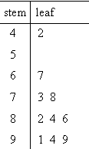
Example #1
Complete a stem-and-leaf plot for the following list of grades on a recent test:
73, 42, 67, 78, 99, 84, 91, 82, 86, 94
First, put the list in order:
42, 67, 73, 78, 82, 84, 86, 91, 94, 99
Then, create the table.

Slide 5
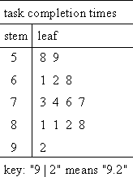
Example #2
Subjects in a psychological study were timed while completing a certain task. Complete a stem and leaf plot for the following list of times:
7.6, 8.1, 9.2, 6.8, 5.9, 6.2, 6.1, 5.8, 7.3, 8.1, 8.8, 7.4, 7.7, 8.2
First, put them in order:
5.8, 5.9, 6.1, 6.2, 6.8, 7.3, 7.4, 7.6, 7.7, 8.1, 8.1, 8.2, 8.8, 9.2
Then, Create the stem and leaf plot.
NOTICE THE KEY

Slide 6
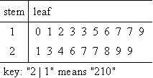
Example #3
List all of the numbers used to create this
Stem and leaf plot.
Make sure to look at the key!
100, 110, 120, 130, 130, 150, 160, 170, 170, 190, 210, 230, 240, 260, 270, 270, 280, 290, 290

Slide 7
Try this…
List out the scores of each player:
0,0,2,4,7,7,9,11,11,13,18,20
Add the player scores to get the score for the team:
0+0+2+4+7+7+9+11+11+13+18+20 = 102

Slide 8
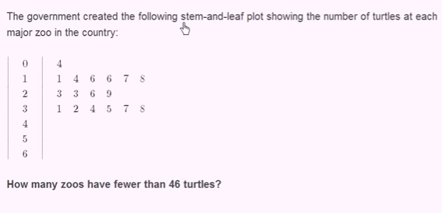
Try This…

Slide 9
Try This…

Slide 10
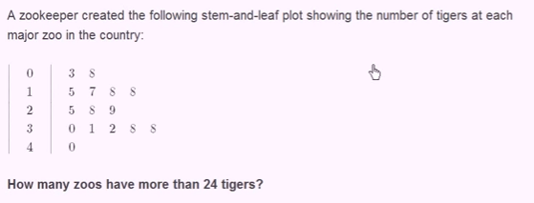
More Practice…

