Slide 1
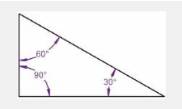
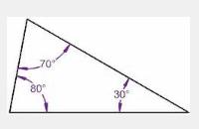
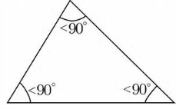
Mystique Monday 4-11 1. Use the image below to answer. Each triangle has a sum of ___° 2. An angle measures 42 degrees more than twice its supplement. What are the two angle measures? 3. 3/5 = g 4 15

Slide 2
AREA of Parallelograms (4-sided shapes with 2 pairs of parallel sides)
bh (base · height) or lw (length · width)
3in 5cm 7in 8in
6in
5cm 11in
A = 6in(3in) A = (5cm)2 A = 11in(7in)
A = 18in² A = 25cm² A = 77in²

Slide 3
Find Area of each shape 1. 2. 12in 5cm 9.3cm 6.8in

Slide 4
Today’s Assignment
Page 432 Complete question 1-7 and 16
Page 433 Complete question 19,
H: Complete Question 25,
M7: Complete Question 26,
and all complete question 27
Work for 20 minutes, then we will take notes on area of triangles.

Slide 5
Area of Triangle – ½ bh or bh 2 1. 2. 11ft 8in 9.1in 8ft 5in 13ft

Slide 6
Continue Assignment
Page 436 Complete Question 1-3, 13-16
Homework IN BLUE WORKBOOK: Page 116 # 1-8

