Slide 1
Mrs. Healey
Mrs. Hibbler
Mrs. Thorpe
Mr. Meyers
Mrs. McRee

Slide 3
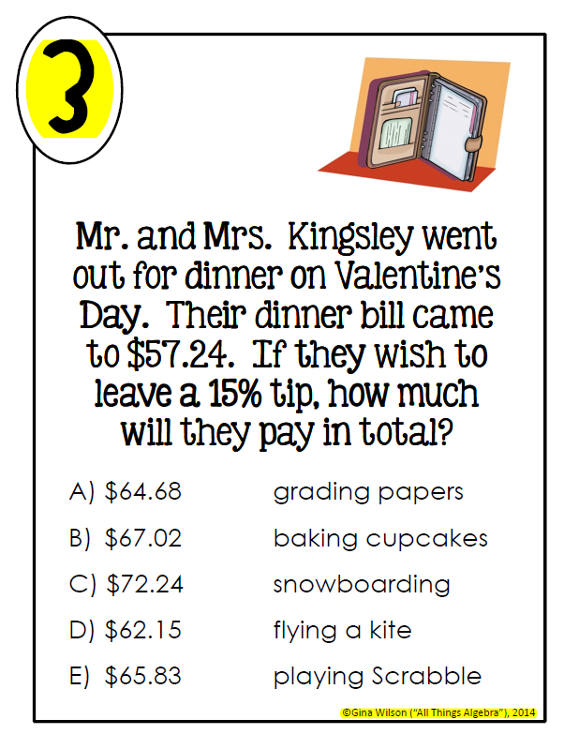

Slide 7
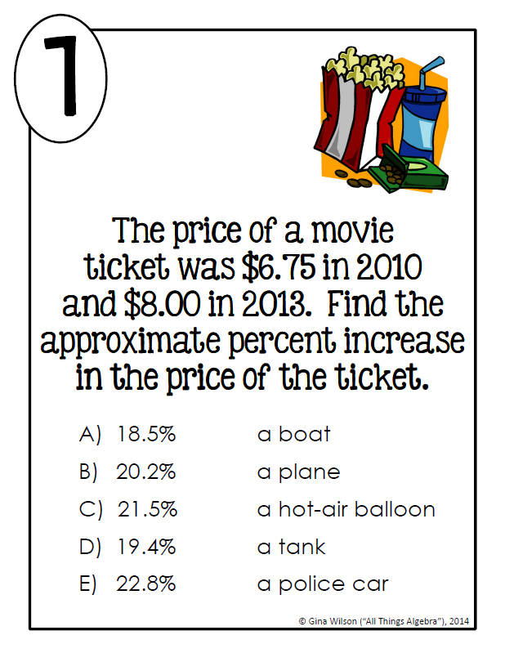

Slide 8
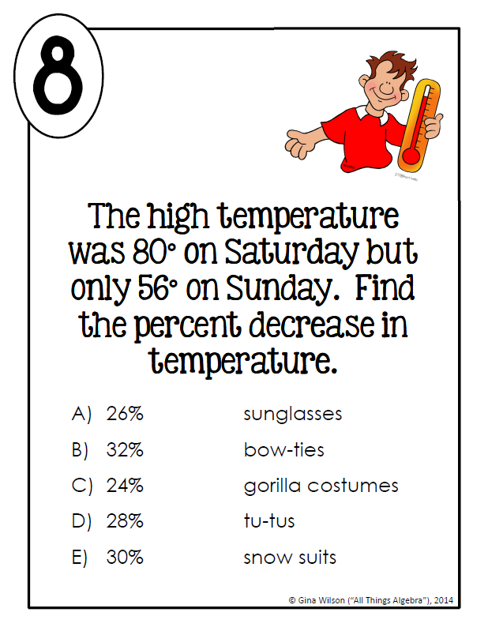

Slide 9
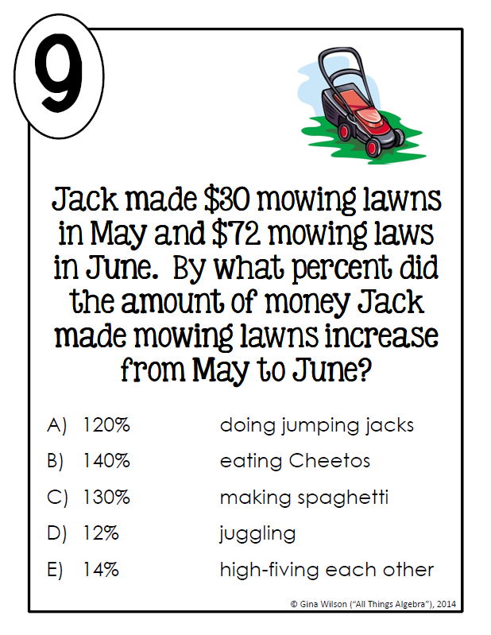

Slide 10
