Slide 1
Composite Figures

Slide 2
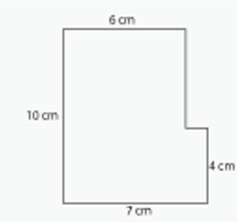
Warm-up 4/14/16
You have just drawn a marvelous stick figure. The paper with the picture
measures 8.5 x 11 . The frame has a width of 1 inch. What is the total area of the picture and
The frame?
2. Kelly had a ribbon that was 5 1/3 feet long. Each piece she cut was 1 1/3 feet long.
How many pieces of ribbon did she cut?
4cm
3. Find the area of the following image:
10cm
4cm
7cm

Slide 3
Directions
Using the provided grid paper, write you name using block letters.
Use some version of your name that is at least 6 letters

Slide 4
Directions
Your name will consist mostly of rectangles and squares.
Include at least one triangle in your name.
Once you have drawn your name.
Write the dimensions for each line of your name
3
3
5
3

Slide 5
Directions
Calculate the area of the composite figures you created by writing the formula for each piece.
Under each letter write the total area for the letter.
Then write the total area for your complete name.

Slide 6
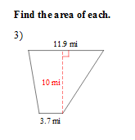
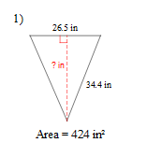
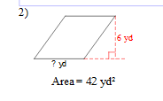
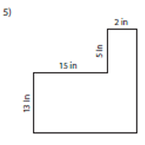
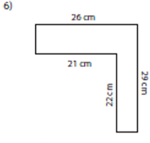
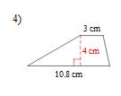
More Practice

